Slide 1


INFT 1012 Network Fundamentals
Week 1 – Topic Outline and Highlights

Slide 2
Topics
Networking today
Impact of network on our lives
Components
Common types of networks
Internet connections
Reliable networks
Basic Switch and End Device Configuration
Basics of IOS (Internetwork Operating Systems)
IOS access
IOS commands
Basic device configuration
IP address configuration

Slide 3
Readings
CCNAv7: Introduction to Networks course text & quizzes
Module 1
Module 2
Available at: www.netacad.com

Slide 4
Networking Today
Highlights

Slide 5
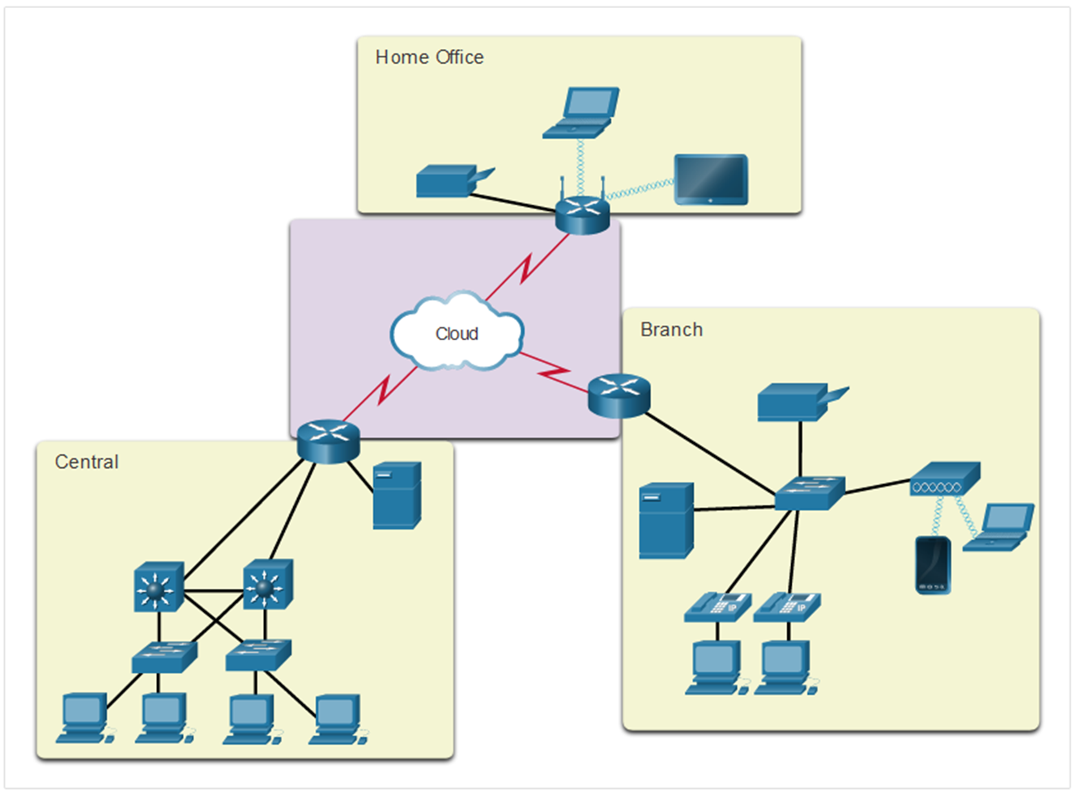
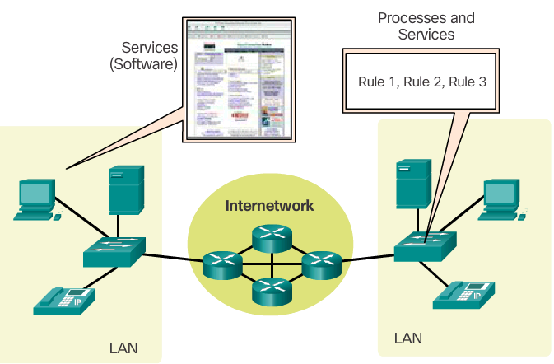
Network Components
Three categories of network components:
End devices (aka Hosts)
Intermediary devices
Network Media
Included in each device, in addition to the device hardware, are the network applications (software), e.g. email or web applications.

Slide 6
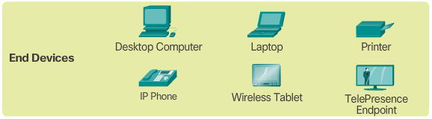

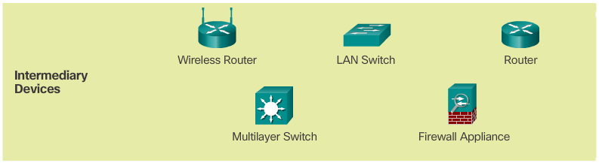

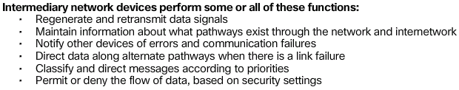
Devices: End Devices vs. Intermediary Devices
An end device is either the source or destination of a message transmitted over the network
Server Computer
Intermediary devices connect the individual end devices to the network and can connect multiple individual networks to form an internetwork
Wireless Access Point

Slide 7
End devices - Clients and Servers
Two types of end devices/hosts:
Servers: computers providing information or service, like email or web pages, to other end devices on the network.
Each service requires separate server software, e.g. a web server requires web server software in order to provide web services to the network.
A server software can provide services simultaneously to many clients.
A single computer can run multiple types of server software.
Clients: computers requesting and displaying the information obtained from the server.
An example of client software is a web browser, like Chrome.
A single computer can also run multiple types of client software.
Client and server software usually run on separate computers, but it is also possible for one computer to be used for both roles at the same time. This type of network is called a peer-to-peer network.

Slide 8
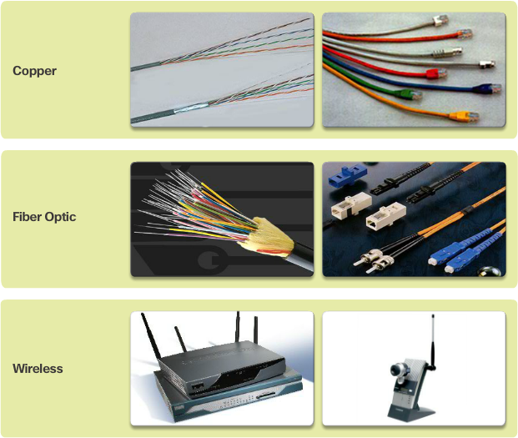
Network Media
The medium provides the channel over which the message travels from source to destination.

Slide 9
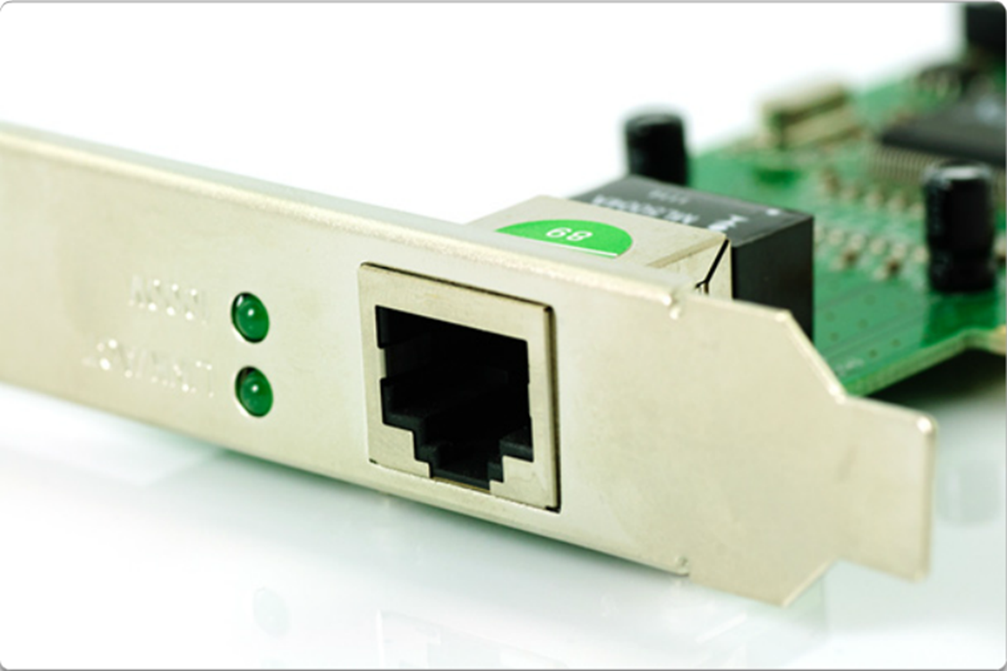
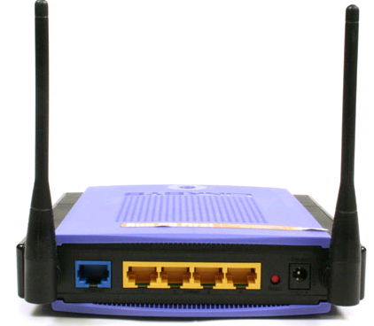
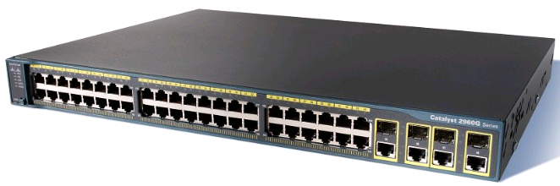
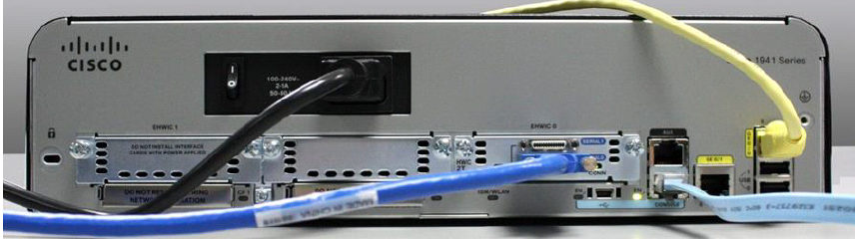
Connections Between Media and Devices
Usually the media connecting the devices plug directly into the Network Interface Cards (NIC) installed on the devices
Terms relating to the connection
Physical Port - A connector or outlet on a device where the media is connected to. For example, an Ethernet port or wireless port on a PC; an Ethernet port or console port on a switch.
Interfaces - Specialized ports on a networking device. Because routers are used to interconnect networks, the ports on a router are often referred to as network interfaces.
Often, the terms port and interface are used interchangeably.

Slide 10
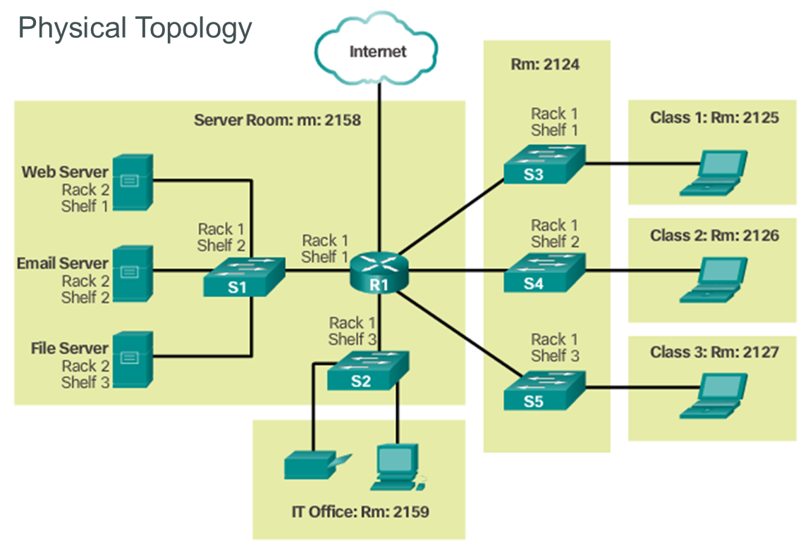
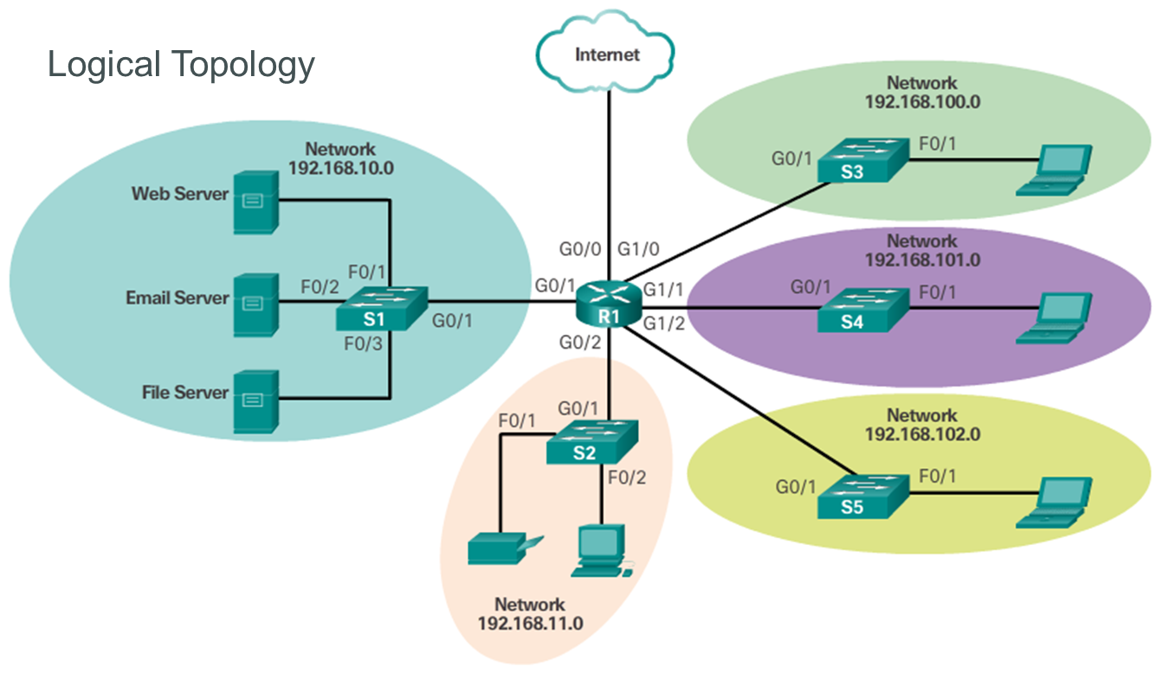
Network Topology Diagrams
Physical topology diagrams identify the physical location of intermediary devices and cable installation.
Logical topology diagrams Identify devices, ports, and addressing scheme.

Slide 11
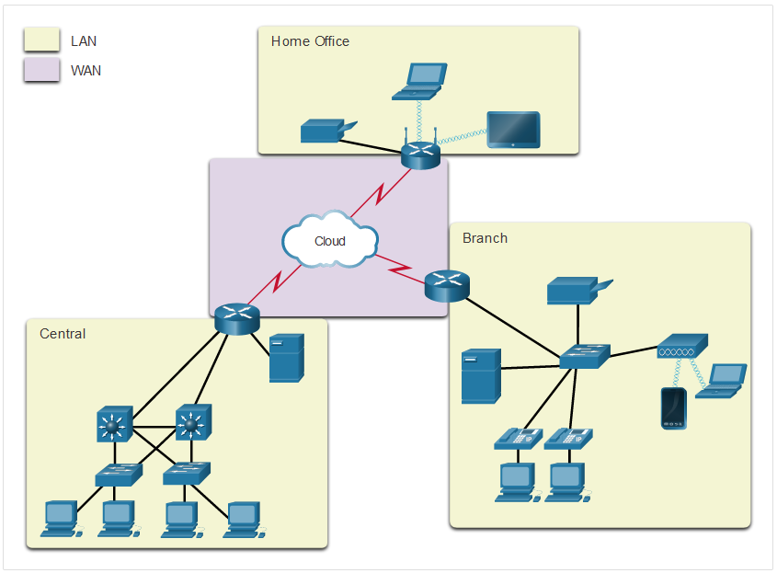
Types of Networks
Network infrastructures vary greatly in terms of area covered, number of users connected, types of services available, and area of responsibility
Two most common types of networks, LAN and WAN
LAN (Local Area Network) | WAN (Wide Area Network)
Interconnect end devices in a limited area. | Interconnect LANs over wide geographical areas.
Administered by a single organization or individual. | Typically administered by one or more service providers.
Provide high-speed bandwidth to internal devices. | Typically provide slower speed links between LANs.

Slide 12
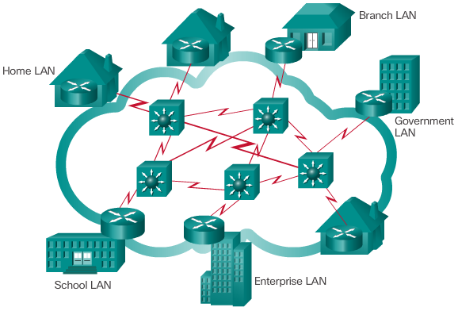
The Internet
The Internet is a worldwide collection of interconnected networks
Notes:
The Internet
The Internet is not owned by any individual or group. Ensuring effective communication across this diverse infrastructure requires the application of consistent and commonly recognized technologies and standards as well as the cooperation of many network administration agencies. There are organizations that have been developed for the purpose of helping to maintain structure and standardization of Internet protocols and processes. These organizations include the Internet Engineering Task Force (IETF), Internet Corporation for Assigned Names and Numbers (ICANN), and the Internet Architecture Board (IAB), plus many others.
The term internet (with a lower case “i") is used to describe multiple networks interconnected. When referring to the global system of interconnected computer networks or the World Wide Web, the term Internet (with a capital “I”) is used.

Slide 13
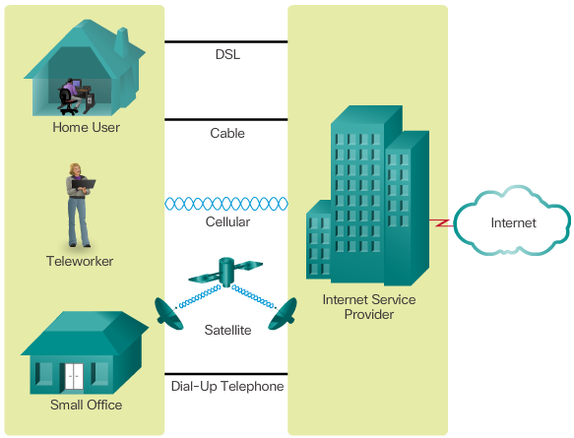
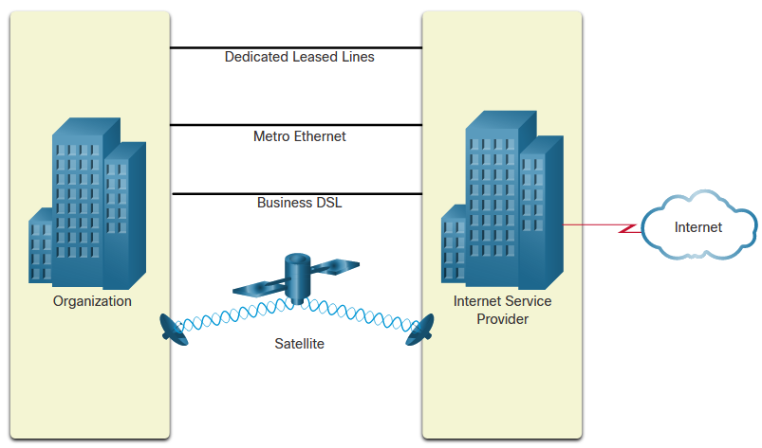
Internet Connections
Businesses: higher bandwidth, dedicated connections and managed services
Home and Small Office
Type | Description
Cable | high bandwidth, always on, internet offered by cable television service providers.
DSL | high bandwidth, always on, internet connection that runs over a telephone line.
Cellular | uses a cell phone network to connect to the internet.
Satellite | major benefit to rural areas without Internet Service Providers.
Dial-up telephone | an inexpensive, low bandwidth option using a modem.
Type of | Description
Dedicated Leased Line | These are reserved circuits within the service provider’s network that connect distant offices with private voice and/or data networking.
Ethernet WAN | This extends LAN access technology into the WAN.
DSL | Business DSL is available in various formats including Symmetric Digital Subscriber Lines (SDSL).
Satellite | This can provide a connection when a wired solution is not available.
Notes:
http://www.abs.gov.au/ausstats/abs@.nsf/mf/8153.0
Cable - Typically offered by cable television service providers, the Internet data signal is carried on the same cable that delivers cable television. It provides a high bandwidth, always on, connection to the Internet.
DSL - Digital Subscriber Lines provide a high bandwidth, always on, connection to the Internet. DSL runs over a telephone line. In general, small office and home office users connect using Asymmetrical DSL (ADSL), which means that the download speed is faster than the upload speed.
Cellular - Cellular Internet access uses a cell phone network to connect. Wherever you can get a cellular signal, you can get cellular Internet access. Performance will be limited by the capabilities of the phone and the cell tower to which it is connected.
Satellite - The availability of satellite Internet access is a real benefit in those areas that would otherwise have no Internet connectivity at all. Satellite dishes require a clear line of sight to the satellite.
Dial-up Telephone - An inexpensive option that uses any phone line and a modem. The low bandwidth provided by a dial-up modem connection is usually not sufficient for large data transfer, although it is useful for mobile access while traveling.
Many homes and small offices are more commonly being connected directly with fiber optic cables. This enables an ISP to provide higher bandwidth speeds and support more services such as Internet, phone, and TV.
The choice of connection varies depending on geographical location and service provider availability.

Slide 14
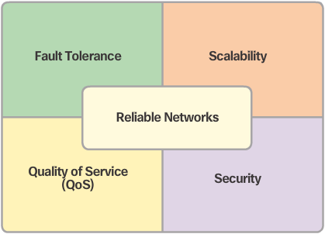
Network Architecture & Reliable Networks
Network architecture refers to the technologies that support the infrastructure and the programmed services and rules, or protocols, that move data across the network.
Four basic characteristics an architecture needs to address to support a reliable network:

Slide 15
Basic Switch and End Device Configuration
Highlights

Slide 16
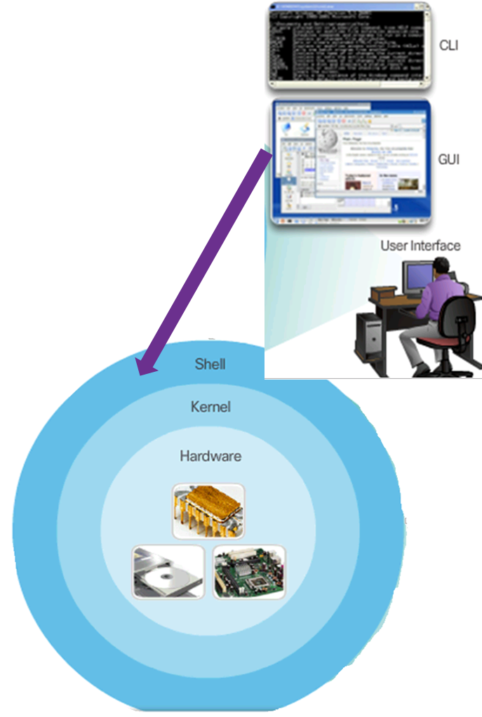
Operating Systems
Every computer requires an OS to function, including “normal” computers, (e.g. desktop, laptop, mainframe computers), mobile devices (e.g. smart phones), and computer-based network devices (e.g. switches, routers).
An OS is system software with two parts:
Shell:
Between users (human users and application programs) and the kernel
Allows users to request specific tasks from the computer.
Requests can be made either through CLI (Command Line Interface) or GUI (Graphical User Interface).
Kernel:
Between Shell and Hardware
Communicates between the hardware and software of a computer and manages how hardware resources are used to meet software requirements.
Notes:
Demo:
Show PC CLI, GUI
In PT, show switch CLI

Slide 17
Methods for accessing CLI of Cisco IOS
Cisco IOS (Internetwork OS) enables the use of keyboard to enter CLI-based text commands to manage or configure a device, and view output on a monitor.
However, Cisco routers and switches normally do not come with a keyboard or monitor, how to access the CLI?
Two major ways to access Cisco CLI:
Directly connect a computer with keyboard and monitor to a Cisco device using a console cable via the device’ console port, a physical management port dedicated to maintenance purpose only.
Remotely connect a computer to a Cisco device via its virtual interface, over a network, e.g. the Internet.
Requires active networking services and the device also needs to have an IP address (so that it can be reached over the network).
Two types of remote connections are available:
Secure Shell (SSH) – secure communication, message encrypted
Telnet – message sent in plain text, not secure
For both access methods, a Terminal Emulation Program needs to be installed and used in the computer.
Notes:
2.1.2.1 Access Methods

Slide 18
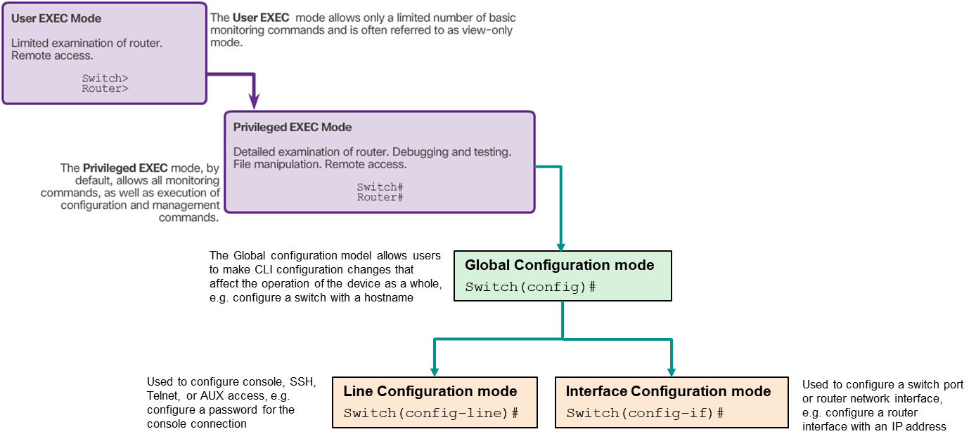
Command Modes
As a security feature, the Cisco IOS software separates management access into the following two command modes: User EXEC & Privileged EXEC modes.
The Cisco IOS modes use a hierarchical structure and are quite similar for both switches and routers.
Notes:
Demo in PT

Slide 19

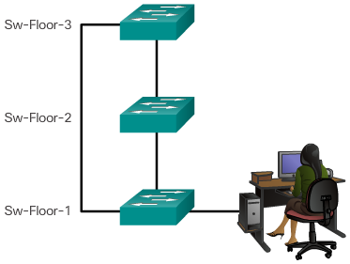
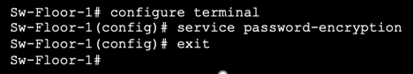
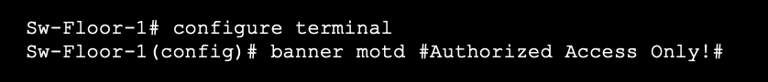
Basic Device configuration
Hostnames allow devices to be identified by network administrators over a network.
Secure access
Password configuration
User EXEC mode password
Privileged EXEC mode password
VTY line password
Other tasks
Encrypt Passwords
Banner Messages

Slide 20
Save or Alter the Running Configuration File
Current configuration is stored in RAM (Random Access Memory) as Running configuration. RAM loses all of its content when the device is powered off or restarted.
To keep the running configuration, save it in NVRAM (non-volatile RAM) as Startup configuration, which will be loaded into RAM as running configuration upon startup or reboot the device.
Switch# copy running-config startup-config
If do not want to keep the current running configuration:
Restore the device to its previous configuration by removing the changed commands individually; Or
Copy the startup configuration file to the running configuration and reload the device from privileged EXEC mode:
Switch# copy startup-config running-config
Switch# reload
System configuration has been modified. Save? [yes/no]: (enter no)
Proceed with reload? [confirm] (press enter to confirm)
Note: If have done copy running-config startup-config before reloading, have to firstly issue erase startup-config, then reload (for a switch, may also need issue delete vlan.dat before reload)

Slide 21
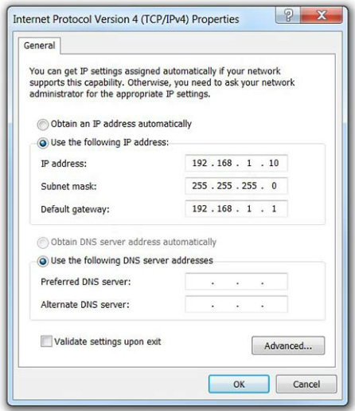
IP Addresses
Each end device on a network must be configured with an IP address
Each router interface requires an IP address to route traffic.
A switch does not need an IP address to work (for devices to connect to it),
but
For a SVI (Switch Virtual Interface) on a switch to work, an IP address must be assigned to it.
SVI provides a means to remotely connect to and manage a switch over a network via a telnet or ssh connection
A switch has one or more SVIs implemented as a piece of software, not a physical port

Slide 22
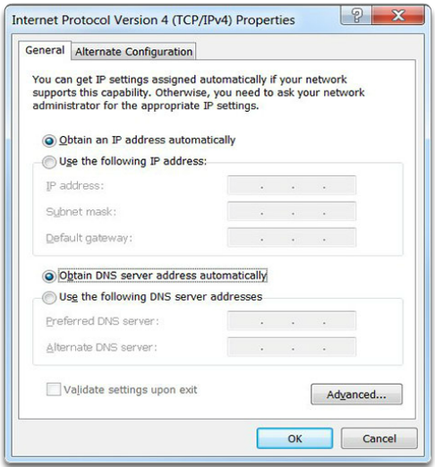
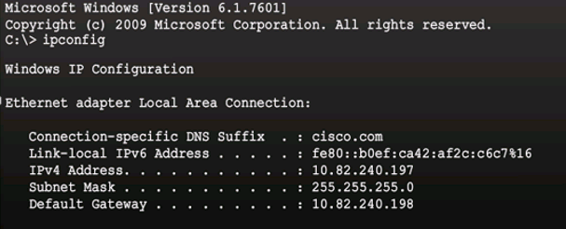
IP Address Configuration for End Devices
Manually Assigning IP Address Information
Automatic IP address configuration by DHCP (Dynamic Host Configuration Protocol)
Can verify PC IP configuration using the ipconfig command in a cmd window

Slide 23
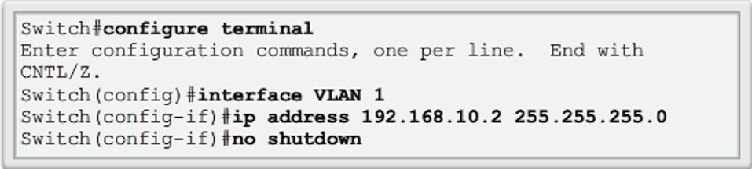
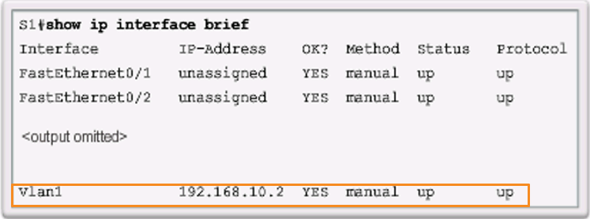
Switch Virtual Interface (SVI) Configuration
Each switch comes with one SVI appearing in the default configuration. The default SVI is interface VLAN1.
To configure a switch’s SVI:
Can verity IP configuration of a switch using the proper show command, e.g. show ip interface brief
Notes:
Demo in PT

Slide 24
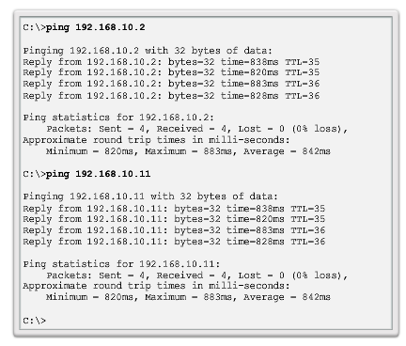
End-to-End Connectivity Test - Ping
Notes:
Demo in PT

